Slide 1
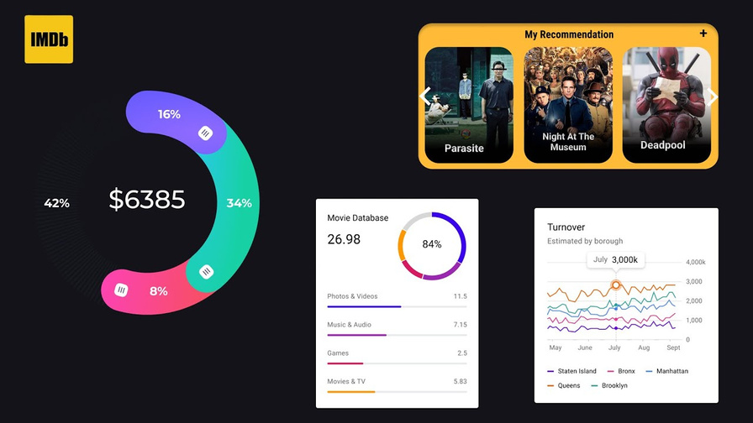

IMDB Movie Analysis
Excel Project - Data Analytics

Slide 2
The dataset provided is related to IMDB Movies. A potential problem to investigate could be: "What factors influence the success of a movie on IMDB?" Here, success can be defined by high IMDB ratings. The impact of this problem is significant for movie producers, directors, and investors who want to understand what makes a movie successful to make informed decisions in their future projects.
Problem Description:

Slide 3
Microsoft Excel:
Version: Microsoft 365 Excel is a part of this suite and offers the latest version of Excel, which is Excel 2019 or later.
Key Features:
Pivot Tables: For summarizing data.
Charts: For data visualization.
Formulas and Functions: For calculations and data analysis (e.g., SUM, AVERAGE, CORREL, MEDIAN, STDEV, COUNTIF).
Tech Task Used:

Slide 4
Data Cleaning: Here are the steps for cleaning data in an IMDb movie analysis using Excel:
First I import the data and then analyze it.
Find the relevant columns for further use.
Find blank cell and delete it.
Remove the irrelevant columns from data.
Lastly find the duplicate data delete it.
Project Approach:

Slide 5
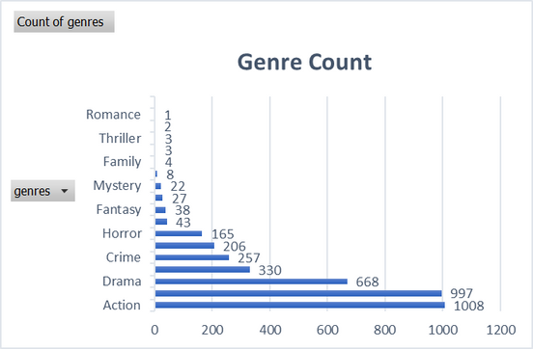
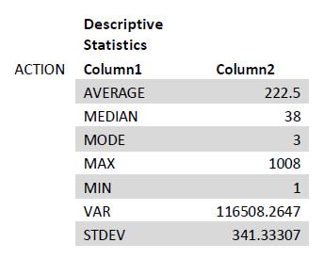
A. Movie Genre Analysis: Analyze the distribution of movie genres and their impact on the IMDB score.
Task: Determine the most common genres of movies in the dataset. Then, for each genre, calculate descriptive statistics (mean, median, mode, range, variance, standard deviation) of the IMDB scores.
Data Analytics Task:
Result:

Slide 6
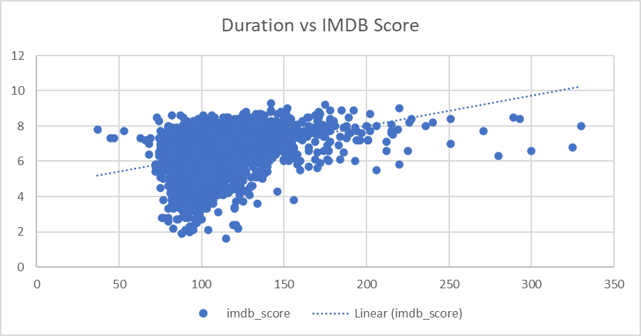
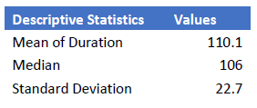
B. Movie Duration Analysis: Analyze the distribution of movie durations and its impact on the IMDB score.
Task: Analyze the distribution of movie durations and identify the relationship between movie duration and IMDB score.
Result:
Data Analytics Task:

Slide 7
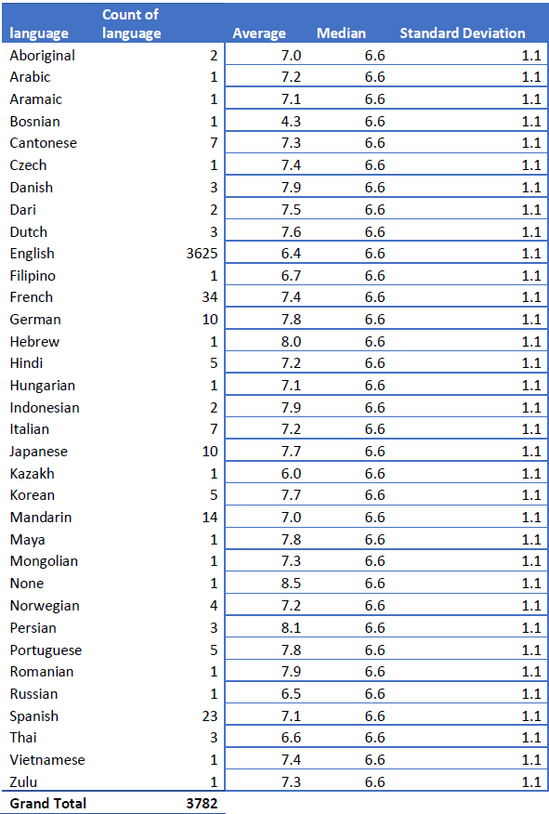
C. Language Analysis: Situation: Examine the distribution of movies based on their language.
Task: Determine the most common languages used in movies and analyze their impact on the IMDB score using descriptive statistics.
Result:
Data Analytics Task:

Slide 8
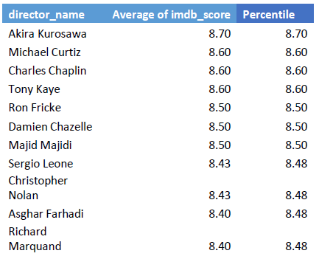
D. Director Analysis: Influence of directors on movie ratings.
Task: Identify the top directors based on their average IMDB score and analyze their contribution to the success of movies using percentile calculations.
Result:
Data Analytics Task:

Slide 9

E. Budget Analysis: Explore the relationship between movie budgets and their financial success.
Task: Analyze the correlation between movie budgets and gross earnings, and identify the movies with the highest profit margin.
Data Analytics Task:
Result:

Slide 10
Movie success on IMDb is influenced by several key factors:
Genre: Certain genres like drama and action often receive higher ratings.
Duration: Movies with moderate runtimes generally perform better.
Language: Films in widely spoken languages or with high production values tend to have higher ratings.
Director: Renowned directors are linked to better ratings.
Budget: Higher budgets usually lead to higher ratings due to better production quality.
These insights can guide producers, directors, and investors in making informed decisions for future projects.
Result:

